Slide 1
Information Technology Institute (ITI)
Virtual Office Management
Session 2 & 3 - MS Word
ITI 490 Virtual Office Management - with Microsoft 365
(formerly Office 365)
Notes:
CANNOT EDIT PURPLE SHAPES OR LOGO
DIVIDER LINE IS EDITABLE
TO CHANGE IMAGE, RIGHT CLICK IMAGE, SELECT “CUT” TO REMOVE EXISTING IMAGE, AND CLICK IMAGE ICON TO INSERT NEW IMAGE
IF NO IMAGE IS IN PLACE, CLICK IMAGE ICON TO INSERT IMAGE

Slide 2
Microsoft Word

Slide 3
Class Outline
Session 2 Word Part I
Session 3 Word Part II
Introduction
Getting Started
Working with Text
Formatting Text
Working with Paragraph Text
Formatting Pages
Creating Lists
Illustrating Documents
Proofing Documents
Sharing and Collaboration

Slide 4
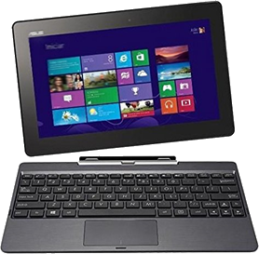
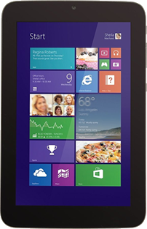
Comparison of Desktop, Web, & Mobile Versions
Word on the Desktop
Traditional computers Comprehensive feature set Full UI Best suited for keyboard and mouse Included in Microsoft 365 subscription
Word for the Web
Web browsers Streamlined feature set Simplified UI Suited for keyboard and mouse Included in Microsoft 365 subscription
Word Mobile App
Mobile devices Limited feature set Adaptable UI Best suited for touchscreen interface Free download from vendor’s app store
Notes:
Same thing occurs for Excel, and PowerPoint.
So while you may have installed or used some of these applications before, please follow along the MyMC account setup and the Office 365 installation to ensure you are using the same version as I am.
No need to worry about overwriting or accidentally deleting your old files. The installation process simply updates your current version if you have one or installs the newest one if you do not.
As I mentioned before, this is a subscription-based service. For this course, Montgomery College is providing us with our own account valid for 1 year. No need to buy anything!
So which version do we get access to? We get access to all of these with our MC account. Once we download Office in a few minutes, you can repeat the process on any other device as long as you use your MyMC account and password.

Slide 5
Getting Started With Word
Navigate in Microsoft Word
Create and Save Word Documents
Edit documents

Slide 6
The Word Application Window

Slide 7
The Ribbon
Tabs
Share
Command groups
Ribbon Display Options button

Slide 8
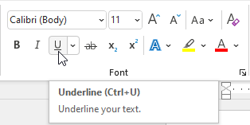
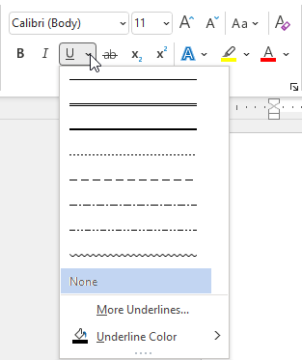
The Ribbon
Dialog box launcher
ScreenTip displayed when you point to a button
Split button arrow
Applies default options or the last options previously set
Options to set

Slide 9
Document Views
Document view: A particular layout in which to view your document
View | Button | Description
Read Mode |  | Shows the document in read-only, full-screen mode in which the document is scrolled side to side instead of up and down.
Print Layout |  | Shows the document as it will appear when printed.
Web Layout |  | Shows the document as it would appear in a web browser.
Outline |  | Shows the document data in a hierarchical mode, enabling you to insert and arrange topics and subtopics.
Draft |  | Shows the document without certain elements, such as graphics, or headers and footers.
9

Slide 10
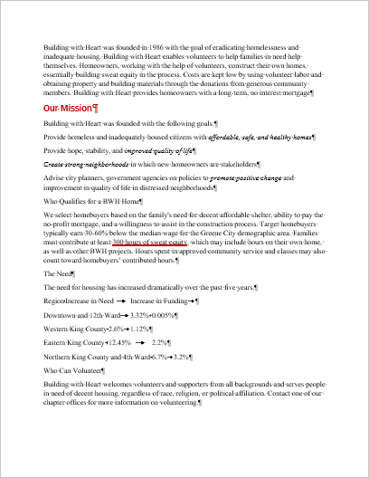
Margins
Top Margin
Left Margin
Right Margin
Bottom Margin

Slide 11
Indent Markers
First line indent marker controls left side of the first line
Hanging indent marker controls left side of lines that wrap
Right indent marker
controls right margin
Left indent marker
moves the first line and hanging markers as a set
The first line indents to the first line indent marker on the left side. When text wraps, it aligns with the hanging indent marker.

Slide 12
Word Start Pane
Notes:
Open file.

Slide 13
The Navigation Pane

Slide 14
Exercise: Navigating within a word Document
Building with Heart is a non-profit volunteer organization that helps families in need buy affordable, safe, and healthy homes
You will open and examine a brochure that was created in Microsoft Word
Notes:
Give students a few minutes to complete.

Slide 15
Tips for beginners…
Use the search bar and the help pane!
Notes:
Enter a keyword or phrase in the Search text box and then select an option from the Get Help on section.
On the Help ribbon tab, select the desired Help & Support button.
Press F1.
Select File and select to open the Word Help window.

Slide 16
Creating and Saving Word Documents

Slide 17
New Document

Slide 18
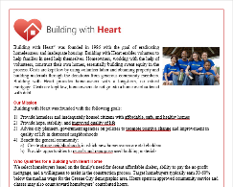
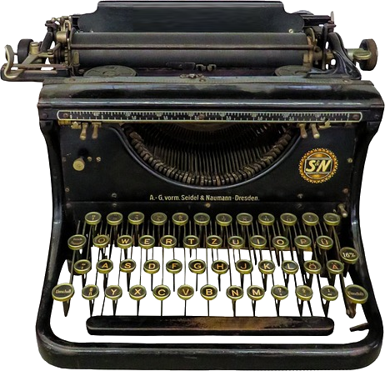
Activity: Saving a Document to a Different File
The Building with Heart.docx fact sheet is still open
You’ll return to that document and make some changes to it
You’ll save the changes in a different file, to leave the original intact
Open
Revise
Save As
Original File
Document in Word
New File
Building with Heart.docx
My Building with Heart.docx

Slide 19
Activity: Saving Revisions in the Current File
You’ve saved the revised document to My Building with Heart.docx
Now you will make another change in the document
You will use “Save” to update the current file
Open
Revise
Save
Original File
Document in Word
Same File
My Building with Heart.docx
My Building with Heart.docx

Slide 20
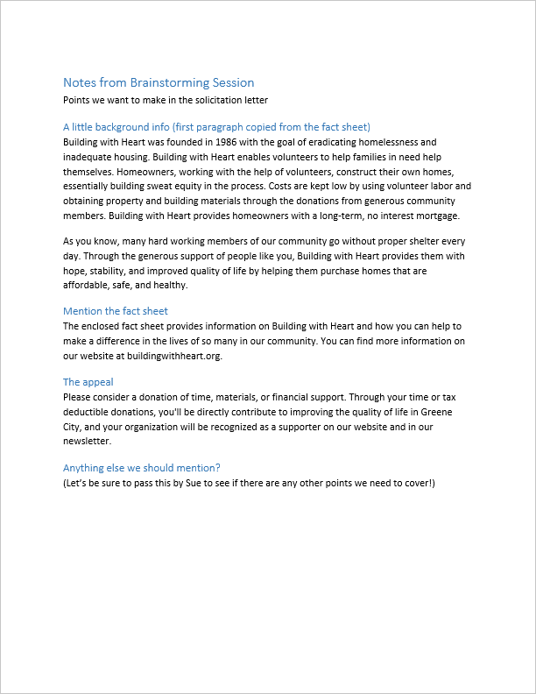
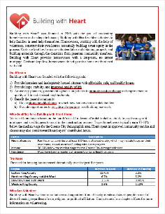
Activity: Managing the Workspace
Open another Word document containing some notes you want to copy into your cover letter
Arrange your workspace to work with two documents side by side

Slide 21
Text Selection Techniques

Slide 22
Getting Started
Open Close and Read Documents
Save New Documents
Use Tell Me Feature (Search)
Red30Conference0103.docx
Red30Conference_final.docx

Slide 23
Working with Text
Inserting New Text
Rearranging text
Copy for Another Source
Red30Conference0201.docx
Red30Conference0202.docx
Red30Conference0203.docx

Slide 24
Formatting Text
Change formatting
Change Text Case
Format text with Style
Red30Conference0301.docx
Red30Conference0302.docx
Red30Conference0303.docx

Slide 25
Working with Paragraph Text
Change paragraph Alignment
Adjust Line Spacing
Keep Text together across page breaks
Put Text into Columns
Red30Conference0401.docx
Red30Conference0402.docx
Red30Conference0403.docx
Red30Conference0404.docx

Slide 26
Formatting Pages
Change Page Layout
Use Headers and Footers
Add page Numbering
Red30Conference0501.docx
Red30Conference0502.docx
Red30Conference0503.docx

Slide 27
Creating Lists
Creature Bulleted and numbered Lists
Edit and Format Lists
Red30Conference0601.docx
Red30Conference0602.docx

Slide 28
Illustrating Documents
Illustrate with a table
Illustrate with Images
Adjust Image in document
Red30Conference0701.docx
Red30Conference0702.docx
Red30Conference0703.docx
Logos

Slide 29
Proofing Documents
Set proofing and autocorrect options
Make your Document accessible
Proof your document with the Editor
Red30Conference0801.docx
Red30Conference0802.docx

Slide 30
Sharing and Collaboration
Print your document
Ad a password for protection
Send document via email
Collaborate on a document in the Cloud
Red30Conference09Final.docx

Slide 31
Class Review
Session 2 Word Part I
Session 3 Word Part II
Introduction
Getting Started
Working with Text
Formatting Text
Working with Paragraph Text
Formatting Pages
Creating Lists
Illustrating Documents
Proofing Documents
Sharing and Collaboration

